Slide 1




2025
Upcoming
Plan
Presented by
Page 1
Opulent Vastr
Next Slide

Slide 2

2025
Company
Vision
Opulent Vastr envisions redefining modern fashion by blending versatility with personalization. As an emerging clothing brand, our mission is to empower individuals to express their unique style through customizable, high-quality apparel that adapts to every occasion. We believe fashion should be as dynamic as the people wearing it — bold, flexible, and ever-evolving. Beyond our online presence, we’re setting our sights on establishing physical stores in major cities, creating immersive spaces where customers can experience our designs firsthand, customize their look, and embrace the future of fashion — one that’s tailored to them.
Page 2
Next Slide

Slide 3


2025
Digital
SOCIAL MEDIA
Marketing
websites
page 3
Next Slide

Slide 4

Studio Shodwe
2025
current
merchandise parteners
Plans
MOKSHA-CULTURAL FEST OF NIT AGARTALA
DZIRE-OFFICIAL DANCE CLUB NIT AGARTALA
FAC-OFFICIAL FINE ARTS CLUB NIT AGARTALA
upcoming plans
OFFICIAL MERCHANDISE PARTNER OF NIT AGARTALA
OFFICIAL MERCHANDISE PARTNER OF NIT SILCHAR
OFFICIAL MERCHANDISE PARTNER OF NIT ARUNACHAL PRADESH
OFFICIAL MERCHANDISE PARTNER OF ALL NORTH-EAST TIER-I,II COLLEGE
Page 4
Next Slide

Slide 5
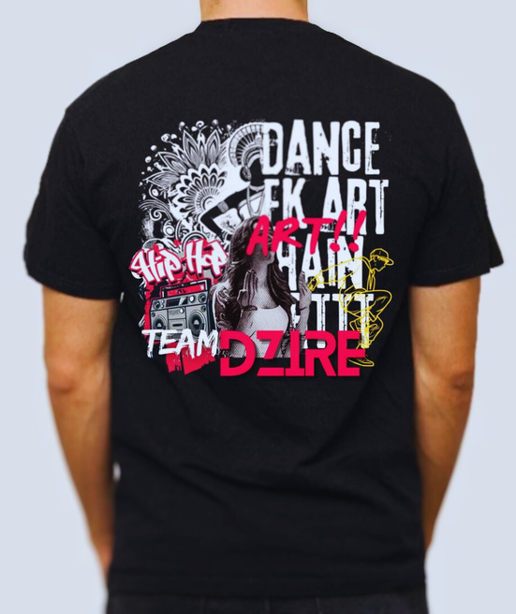
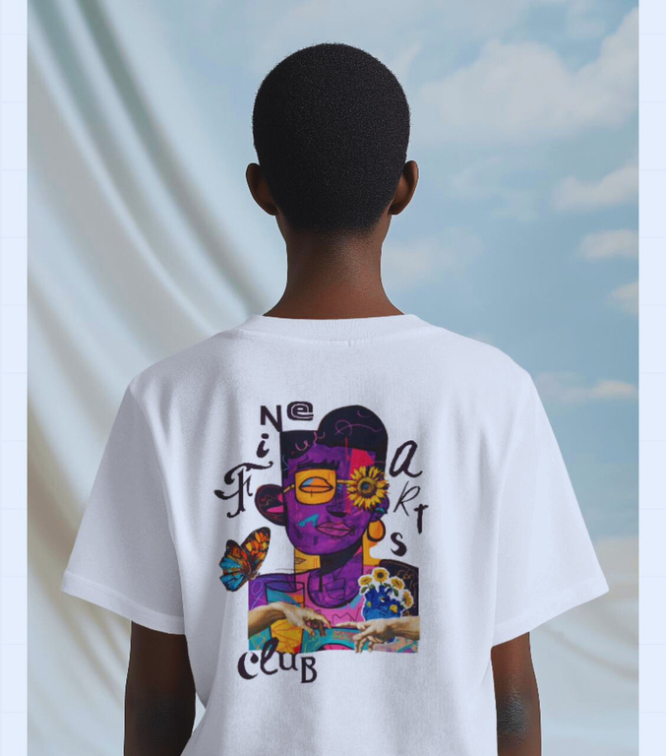
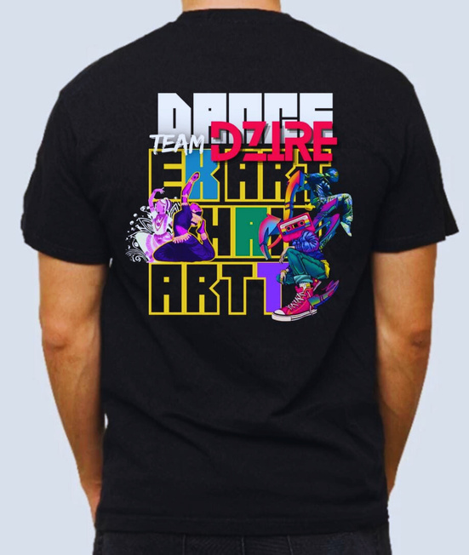
2025
Work
Our
page 5
Next Slide

Slide 6


2025
Thank
You!
contacts:
@opulent vastr
opulentvastr@gmail.com
+91 9097743928
page 6

